Slide 1
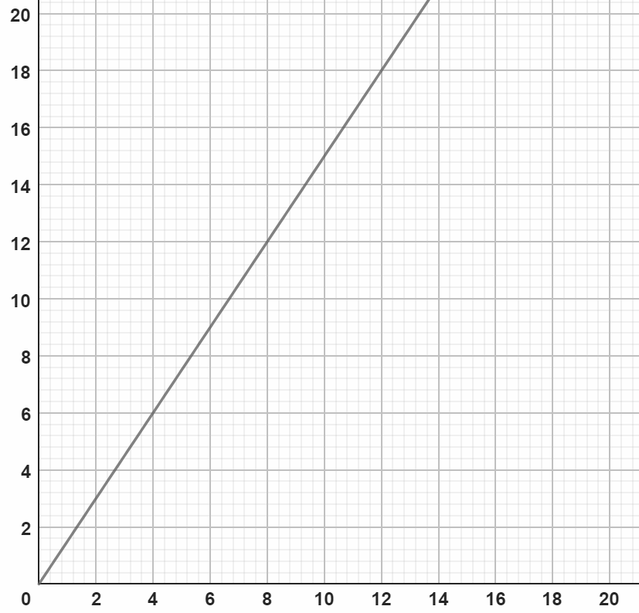
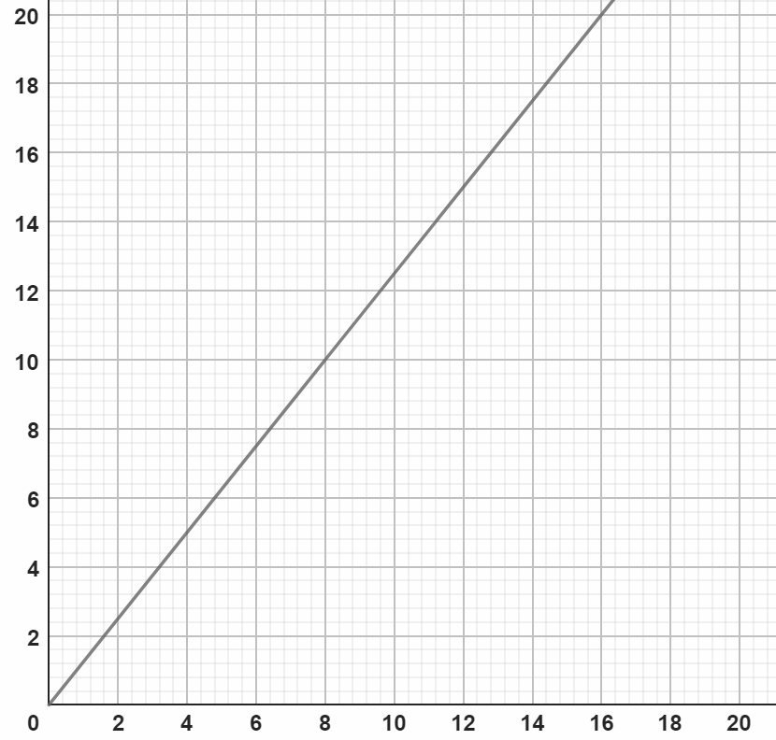
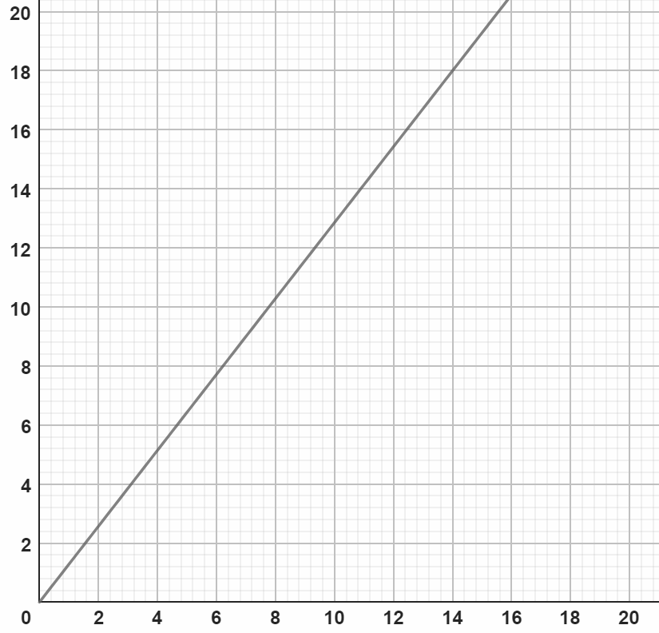
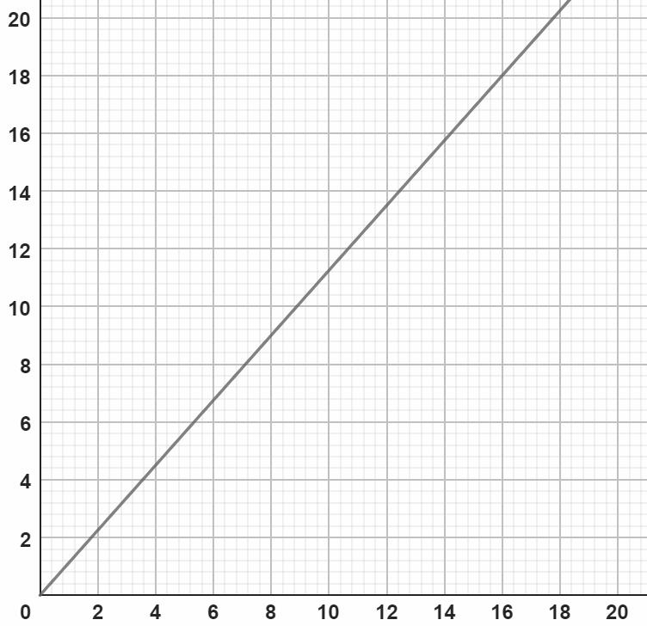
Describing exchange rates with ratio
Task A: Representations of exchange rates
1) Draw a graph and estimate the conversions.
a) £10 = $15
b) £8 = €10
$
€
£
£
£8 = $12
£6 = €7.20 to €7.80
$6 = £4.
€4 = £3 to £3.40 .
c) £14 = €18
d) £16 = $18
€
$
£
£
£5 = €6.20 to €6.80
£11 = $12.20 to $12.70
€16 = £12.20 to £12.70
$8 = £6.80 to £7.20

Slide 2

Describing exchange rates with ratio
Task B: Writing exchange rates as a ratio
1) Find the missing values in the following tables given the exchange rate in the top row.
a)
b)
c)
£ | €
1 | 1.15
280 | 322
$ | £
1 | 0.79
50 | 39.50
£ | ¥
1 | 185
15 | 2775
d)
€ | £
1 | 0.9
25 | 22.50
e)
£ | ¥
1 | 185
12.50 | 2312.50
f)
£ | $
1 | 1.25
87 | 108.75
2) Andeep is comparing prices of sunglasses in the UK, the USA and France.
Rank the following from cheapest to most expensive.
£45.00
$57.00
£1 : $1.25
€54.24
£1 : €1.20
£ | $
1 | 1.25
45.60 | 57
£ | €
1 | 1.20
45.20 | 54.24
On order from cheapest to most expensive: UK, France & USA.
Mathematics in Education and Industry
v2.3

